Slide 1
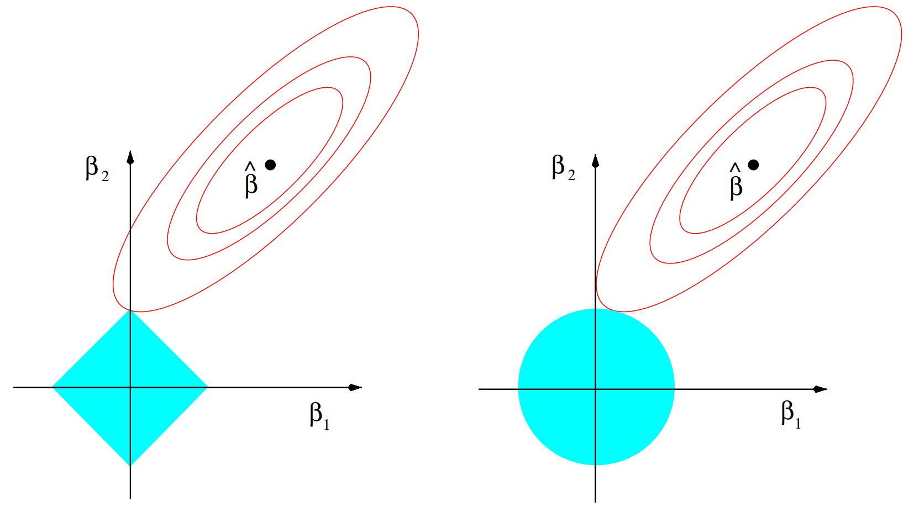







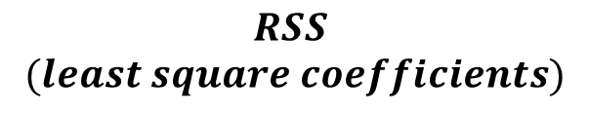



$$Elliptical$$
$$countours of RSS$$
$$β_{2}$$
$$β_{2}$$
$$\hat{β}$$
$$\hat{β}$$
$$Lasso$$
$$coefficients$$
$$RSS$$
$$(least square coefficients)$$
$$Ridge regression$$
$$coefficients$$
$$β_{1}$$
$$β_{1}$$
$$\left|β_{1}\right|+\left|β_{2}\right|≤C$$
$$β_{1}^{2}+β_{2}^{2}≤C$$
$$Penalty term shown$$
$$as a constraint region$$
LASSO
RIDGE REGRESSION

